Slide 1
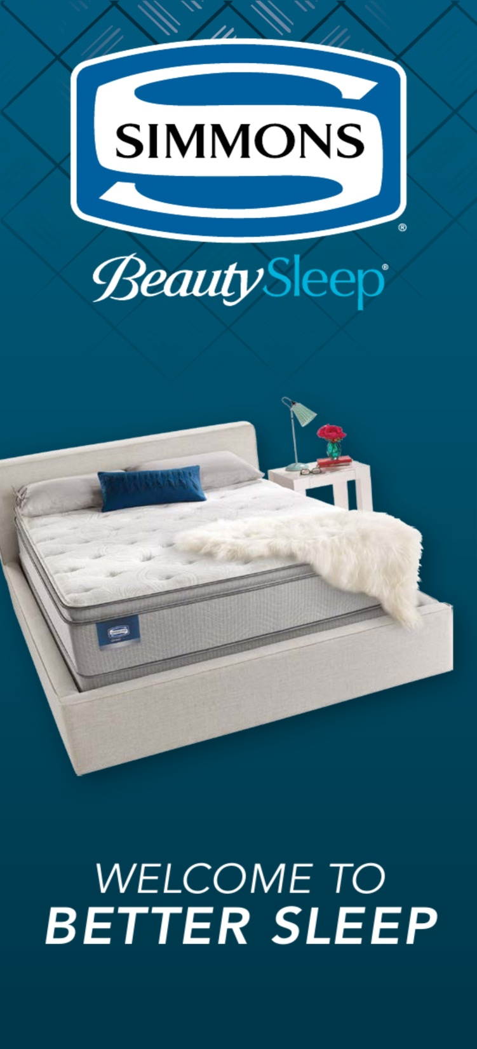
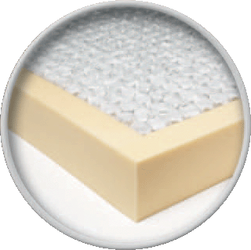
Naples Plush
Built in the USA
700 Series BeautySleep Individually “Wrapped” Coils (15 ½ Ga.)
Comfort Layers
………FR Fiber
………1” AirCool® Foam
………1/2” GelTouch® Foam
Coil Construction Insulators
………Top – Quantum Lock Insulator
………Bottom – 1” Layer Energy Foam™
Edge Support– 3” Foam Encasement Edge Support
Warranty – 10 Yr. Non-Prorated
Twin Set
Full Set
Queen Set
King Set
$000
$000
$000
$000

Slide 2
Columbia Firm
Built in the USA
700 Series BeautySleep Individually “Wrapped” Coils (14 Ga.)
Comfort Layers
………FR Fiber
………1” AirCool® Foam
………1/2” Energy Foam™
Coil Construction Insulators
………Top – Quantum Lock Insulator
………Bottom – 1” Layer Energy Foam™
Edge Support– 3” Foam Encasement Edge Support
Warranty – 10 Yr. Non-Prorated
Twin Set
Full Set
Queen Set
King Set
$000
$000
$000
$000

Slide 3

Bolivar Plush
Built in the USA
700 Series BeautySleep Individually “Wrapped” Coils (15 ½ Ga.)
Comfort Layers
………FR Fiber
………1 ¼” AirFeel™ Foam
………1” AirCool® Foam
………1/2” GelTouch® Foam
………Center 1/3 Memory Foam support
Coil Construction Insulators
………Top – Quantum Lock Insulator
………Bottom – 1” Layer Energy Foam™
Edge Support– 3” Foam Encasement Edge Support
Warranty – 10 Yr. Non-Prorated
Twin Set
Full Set
Queen Set
King Set
$000
$000
$000
$000

Slide 4
Bolivar Plush PillowTop
Built in the USA
700 Series BeautySleep Individually “Wrapped” Coils (15 ½ Ga.)
Comfort Layers
………FR Fiber
………1 ¼” AirFeel™ Foam
………1” AirCool® Foam
………1 ½” Plush Comfort Foam
………1/2” GelTouch® Foam
………Center 1/3 Memory Foam support
Coil Construction Insulators
………Top – Quantum Lock Insulator
………Bottom – 1” Layer Energy Foam™
Edge Support– 3” Foam Encasement Edge
Warranty – 10 Yr. Non-Prorated
Twin Set
Full Set
Queen Set
King Set
$000
$000
$000
$0000

